Slide 1
Pascal’s Triangle and Prime Numbers

Slide 2
The Triangle
1
1 1
1 2 1
1 3 3 1
1 4 6 4 1
1 5 10 10 5 1
1 6 15 20 15 6 1
1 7 21 35 35 21 7 1
1 8 28 56 70 56 28 8 1

Slide 3

Powers of 2
$\sum_{k=0}^{n}{\left(\begin{matrix}n \\ k\end{matrix}\right)=2^{n}}$
1 = 2⁰
1+1 = 2¹
1+2+1 = 2²
1+3+3+1 = 2³
1+4+6+4+1 = 2⁴

Slide 4
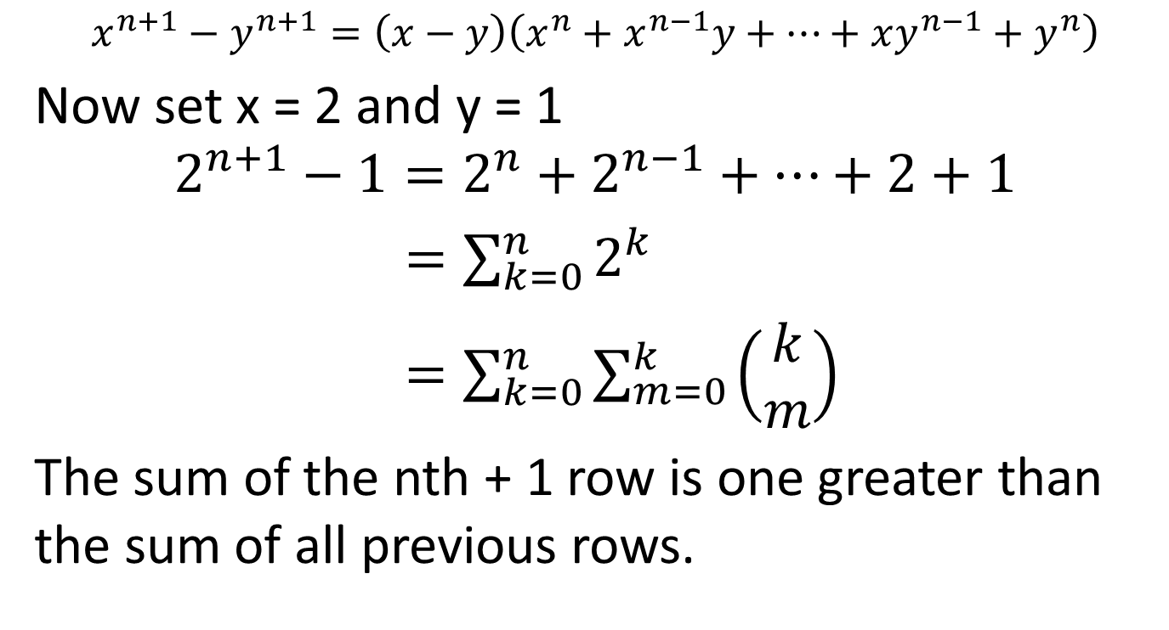
Difference of powers
$$x^{n+1}−y^{n+1}=\left(x−y\right)\left(x^{n}+x^{n−1}y+…+xy^{n−1}+y^{n}\right)$$
Now set x = 2 and y = 1
$$2^{n+1}−1=2^{n}+2^{n−1}+…+2+1$$
$=\sum_{k=0}^{n}{2^{k}}$
$=\sum_{k=0}^{n}{\sum_{m=0}^{k}{\left(\begin{matrix}k \\ m\end{matrix}\right)}}$
The sum of the nth + 1 row is one greater than the sum of all previous rows.

Slide 5
Example
4th row
1+4+6+4+1 = 2⁴ = 16
1+2+4+8 = 15 = 2⁴-1
1+1+1+1+2+1+1+3+3+1 = 15

Slide 6
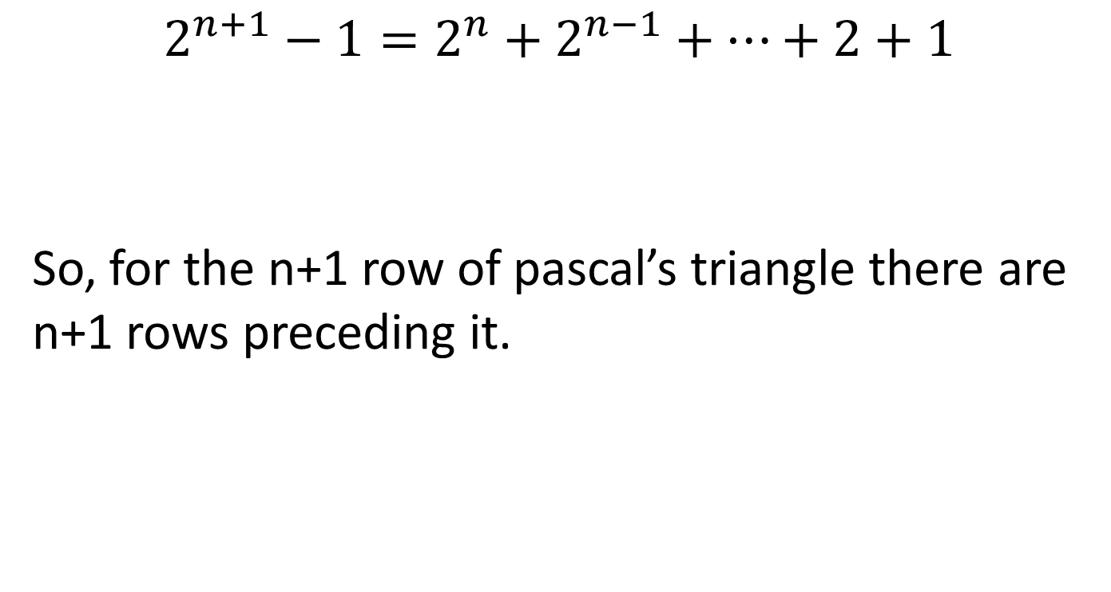
Closer look at Difference Relation
$$2^{n+1}−1=2^{n}+2^{n−1}+…+2+1$$
So, for the n+1 row of pascal’s triangle there are n+1 rows preceding it.
n+1 terms

Slide 7
The Primes
If 2^{n}-1 is prime, then so is n
If n is a composite number xy
2^{n}-1 is divisable by 2^{y}-1
Well known and established proof

Slide 8
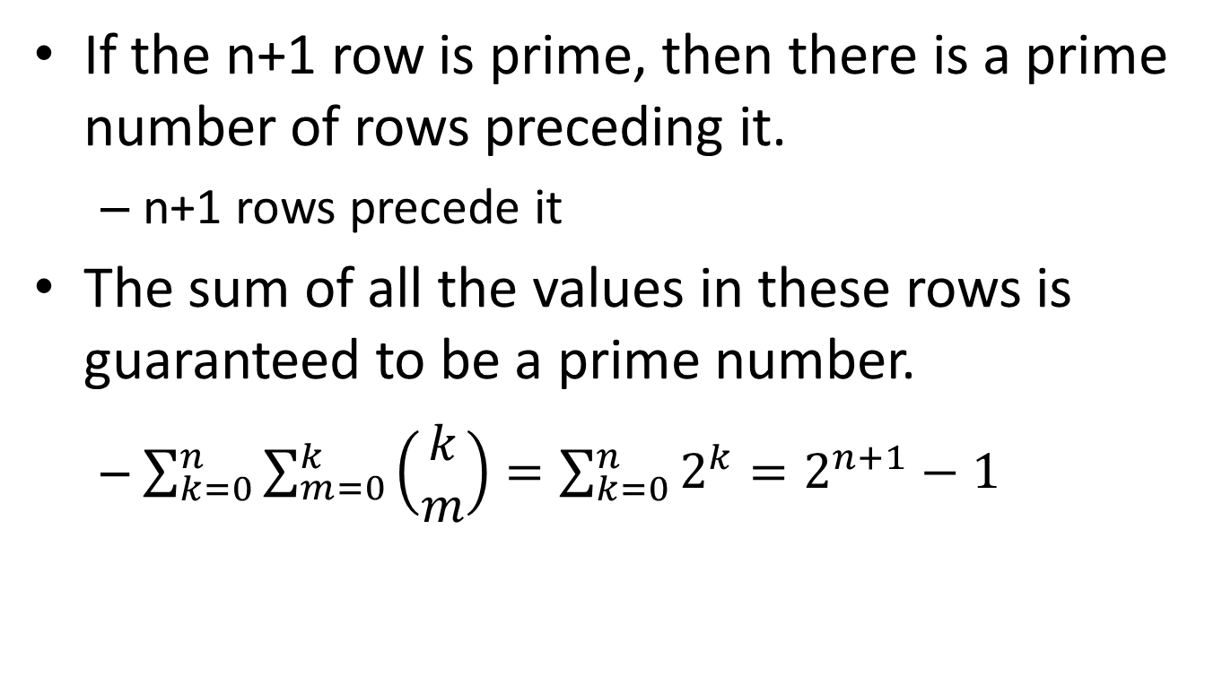
The Primes and the Triangle
If the n+1 row is prime, then there is a prime number of rows preceding it.
n+1 rows precede it
The sum of all the values in these rows is guaranteed to be a prime number.
$\sum_{k=0}^{n}{\sum_{m=0}^{k}{\left(\begin{matrix}k \\ m\end{matrix}\right)}}=\sum_{k=0}^{n}{2^{k}}=2^{n+1}−1$

Slide 9
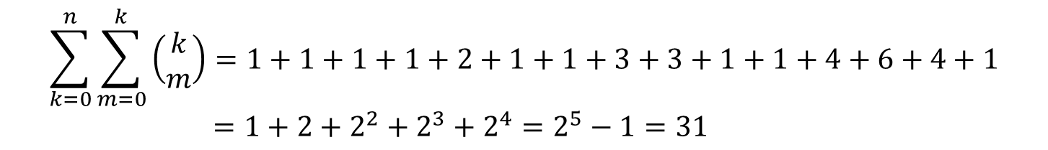

Example
$$1$$
$$1 1$$
$$1 2 1$$
$$1 3 3 1$$
$$1 4 6 4 1$$
$$1 5 10 10 5 1 =2^{5}$$
1
2
3
4
5
$$\sum_{k=0}^{n}{\sum_{m=0}^{k}{\left(\begin{matrix}k \\ m\end{matrix}\right)=1+1+1+1+2+1+1+3+3+1+1+4+6+4+1}}$$
$=1+2+2^{2}+2^{3}+2^{4}=2^{5}−1=31$

